Slide 1
Bewerley Park March 18th – 20th
Year 3,4,5,6 from Kirkby Malzeard and St Nicholas Schools

Slide 2
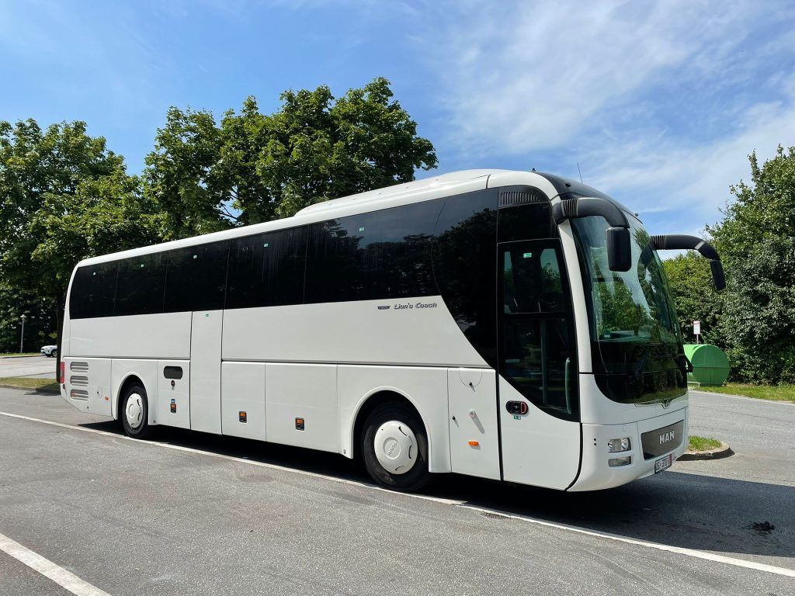
We leave on Monday morning, returning after lunch on the Wednesday.
Transported to and from school by coach. Drop and collect as normal.

Slide 3
Bewerley park – why go on residential

Slide 4
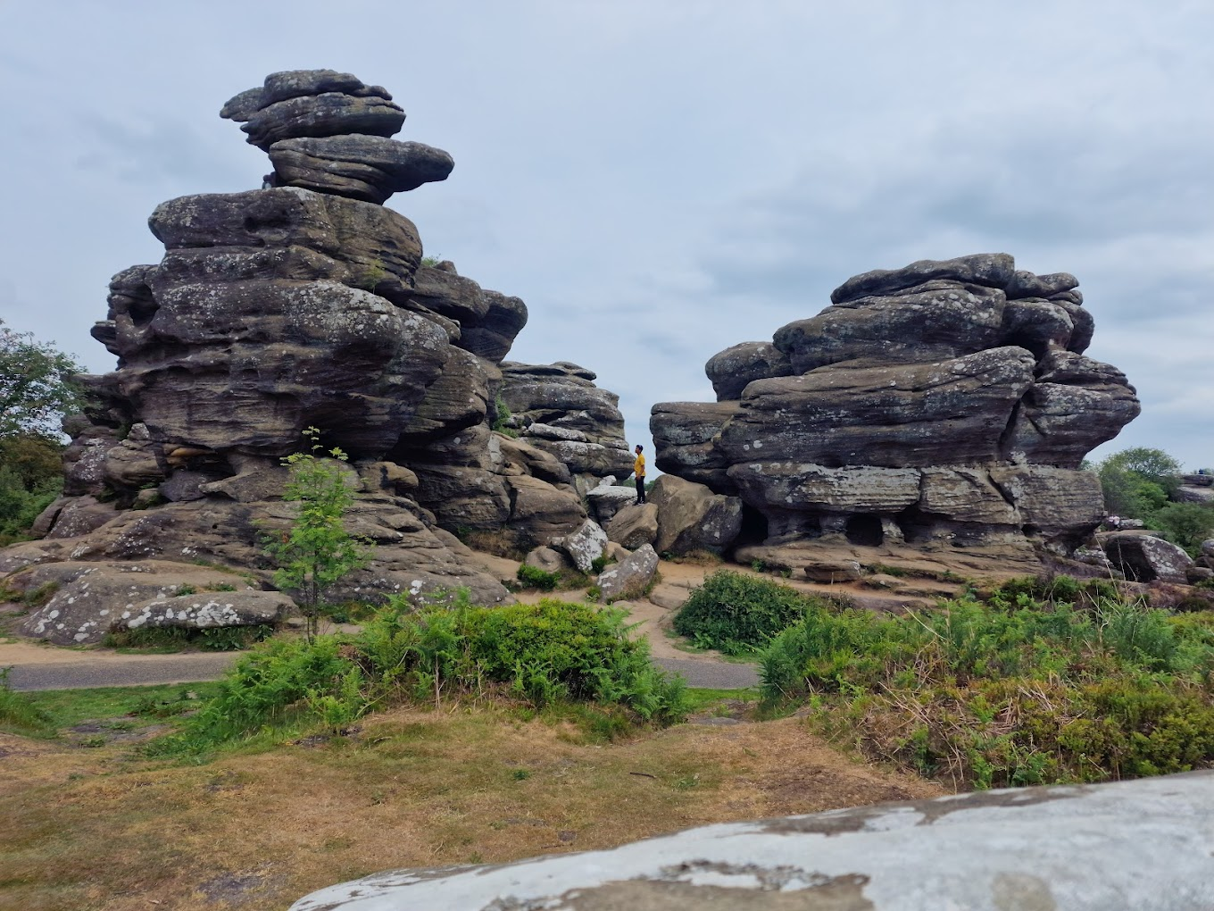
Bewerley park – why go on residential
Links to our studies in school
Geography and History we have studied changing Nidderdale landscapes
Geography we are learning about rocks and will visits Brimham rocks

Slide 5
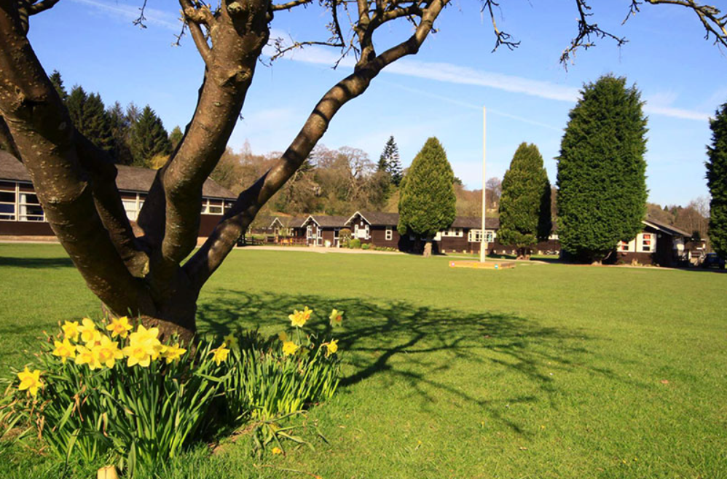
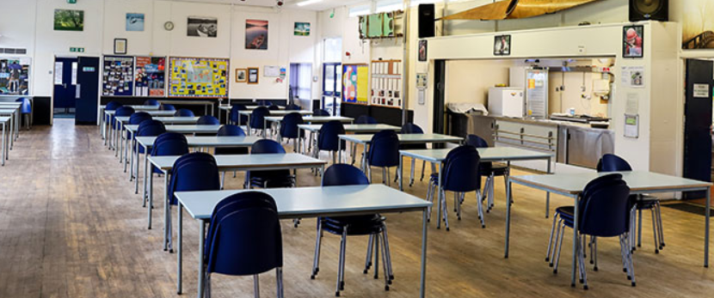
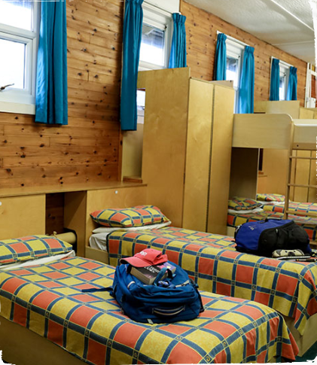
Bewerley park …
https://outdoored.co.uk/bewerley-park-outdoor-centre/

Slide 6
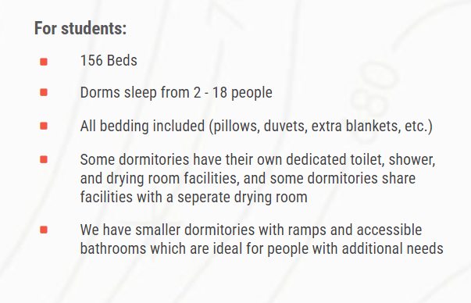
Bewerley park …

Slide 7
Bewerley park – all your questions answered

Slide 8
Bewerley park – your questions answered
Parent section of the website contains all the information needed for the visit:
https://outdoored.co.uk/parents-and-carers-hub/
Kit needed
Accommodation
Food
Activities
Peace of mind
PLEASE DO NOT SEND ANY FOOD, DRINK OR SNACKS FROM HOME
outdooreducation@northyorks.gov.uk, or give us a call on 01609 797777.

Slide 9
What activities?
The year 3/4 and the year 5/6 will work separately during the visit.

Slide 10
Raft building Year 3 and 4

Slide 11
Rock climbing Year 3 and 4

Slide 12
Troller’s ghyll Year 3 and 4

Slide 13
Woodland adventures and treasure quest Year 3 and 4

Slide 14
Canoeing Year 5 and 6

Slide 15
Rock climbing Year 5 and 6

Slide 16
River walk Year 5 and 6

Slide 17
Shelter building Year 5 and 6

Slide 18
Which staff are attending?
Mr Anson
Miss Oates
Mrs Buggy
Mrs Martin
Mrs Fernley
Miss Pawson
Miss Mandelson
Mrs Marlow/Mrs Johnson
Mrs Taylor

Slide 19
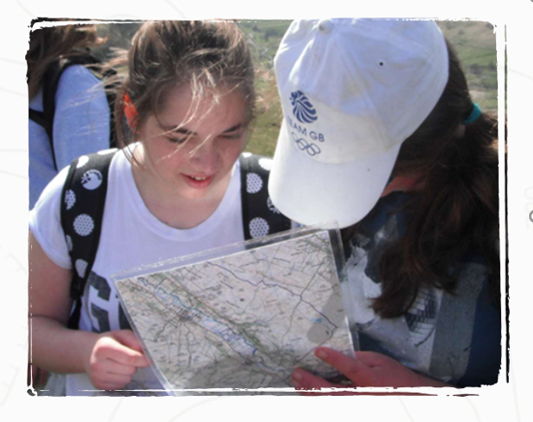
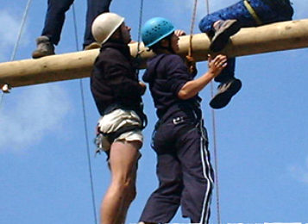
The evenings – day 1
Year 5 and 6
Year 3 and 4
Night walk…
Night line and timber trails

Slide 20
The evenings – day 2
The social…
The children will decide!
Play outside
Film night
Quiz night
Fire pit
Tuck shop

Slide 21
Medication
Any medication must be handed into the school office on the Friday before departure
Only medication prescribed by a doctor can be administered and only when accompanied by a completed consent to give medicines form. These are available on the school website
Please ensure that your child’s medical details are updated with school.

Slide 22
Money
Keep sakes…
If you would like your child to purchase a keep sake from the tuck shop, they can bring up to £5.00 in a named envelope. This must be handed into school the Friday before departure.
 | Mugs – Stripey |  |  |  |  |  | £4.00
 | Mugs - white |  |  |  |  |  | £4.00
 | Bottle Blue/White |  |  |  |  |  | £3.50
 | Buff |  |  |  |  |  | £4.00
 | Pencil |  |  |  |  |  | 50p
 | Highlighter Pen |  |  |  |  |  | £2.50
 | Purse |  |  |  |  |  | £2.00
 | Soft Toy – Duck |  |  |  |  |  | £5.00
 | Soft Toy – Rabbit |  |  |  |  |  | £5.00
 | Soft Toy – Hedgehog |  |  |  |  |  | £5.00
 | Soft Toy – Owl |  |  |  |  |  | £5.00
 | Soft Toy – Pig |  |  |  |  |  | £5.00
 | Torch |  |  |  |  |  | £4.00
Tuck shop treats
The students may also bring £1.25 in a named envelope to buy one treat from the tuck shop on the last night of the residential.
This must be handed into school the Friday before departure.

Slide 23
Don’t forget and top tips…
A teddy!
Tuck shop £1.25 and up to £5.00 for a keep sake (in an envelope with your child's name on and handed into the school office by Friday).
No electronics
A small book or note pad or pack of cards or uno type game for the dorm if time.
Pack soft bags not large, hard sided suitcases so we can get all the luggage on the coach.
Bin liners for wet gear
Medications
PLEASE DO NOT SEND YOUR CHILD WITH ANY FOOD, DRINK or SNACKS FROM HOME

Slide 24
What needs to be done by when
Updated medical forms and permission forms to school – Monday 5th February
Medical forms and medication – Friday 15th March 9am
Tuck shop money (£5 max) and treat money (£1.25 max) in a named envelope – Friday 15th March 9am

Slide 25
Any Questions…

